Slide 1



DEPARTMENT OF ELECTRONICS AND COMMUNICATION ENGINEERING
A SYSTEM FOR CONTROLLING THE FLOW OF FLUID IN A FLOW CONTROL VALVE
Team members :
PRABIKA .R (927622BEC146)
SANTHIGA.P (927622BEC174)
SANJITHA.R (927622BEC173)
RITHIKA.G (927622BEC166)
GUIDED BY :
DR. K .SIVANANDAM

Slide 2
INTRODUCTION
.
The Wireless Flow Control System, designed for the paper-making industry, features a Wi-Fi-enabled valve that automatically adjusts water flow based on moisture levels in mixtures of pulps, papers, and sawdust.
Real-time moisture levels are displayed on an LCD screen and stored via LAN for historical analysis.

Slide 3
PROBLEM STATEMENT
In the paper-making industry, maintaining optimal moisture levels in mixtures of pulps, papers, and sawdust is critical. Current manual water control methods result in inefficiencies, inconsistencies, and increased waste. There is a need for a more precise, automated solution to monitor and control moisture levels. This solution should include real-time data display on an LCD and the capability to store moisture data for historical analysis using a LAN system, to enhance process efficiency and product quality.

Slide 4
EXCISTING SYSTEM
In the current wired automatic flow control systems used in the paper-making industry, water flow is regulated based on the moisture levels in mixtures of paper, pulps, and sawdust. Wired moisture sensors are installed to continuously monitor the moisture content in these mixtures. The sensors transmit data through cables to a central control unit, which processes the information and adjusts the water flow to maintain optimal moisture levels. While these systems are capable of precise control, they are hindered by the complexity of wiring, potential maintenance issues, and limited flexibility in adapting to changing production layouts.

Slide 5
PROPOSED SYSTEM
We propose a wireless flow control system designed for the paper-making industry, where a Wi-Fi-enabled valve automatically adjusts water flow based on real-time moisture levels in mixtures of pulps, papers, and sawdust. Moisture sensors will continuously monitor the levels, displaying data on an LCD screen for immediate feedback. Additionally, the system will store moisture data via LAN for historical analysis, ensuring precise control and optimization of the manufacturing process, enhancing efficiency, and reducing waste

Slide 6
BLOCK DIAGRAM
From pipe line
Relay
Arduino
(Nano)
Lan
Wifi integrated valve
Moisture controller
Local disk

Slide 7
WORK COMPLETION
The water flow control system is designed with Wi-Fi module to regulate water flow based on the moisture. The lcd display will showcase the real-time water flow data, ensuring operators can monitor. The real-time data and previous data is stored using LAN

Slide 8
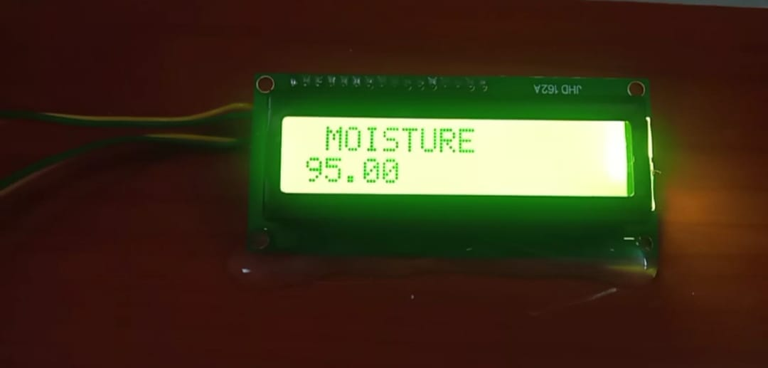
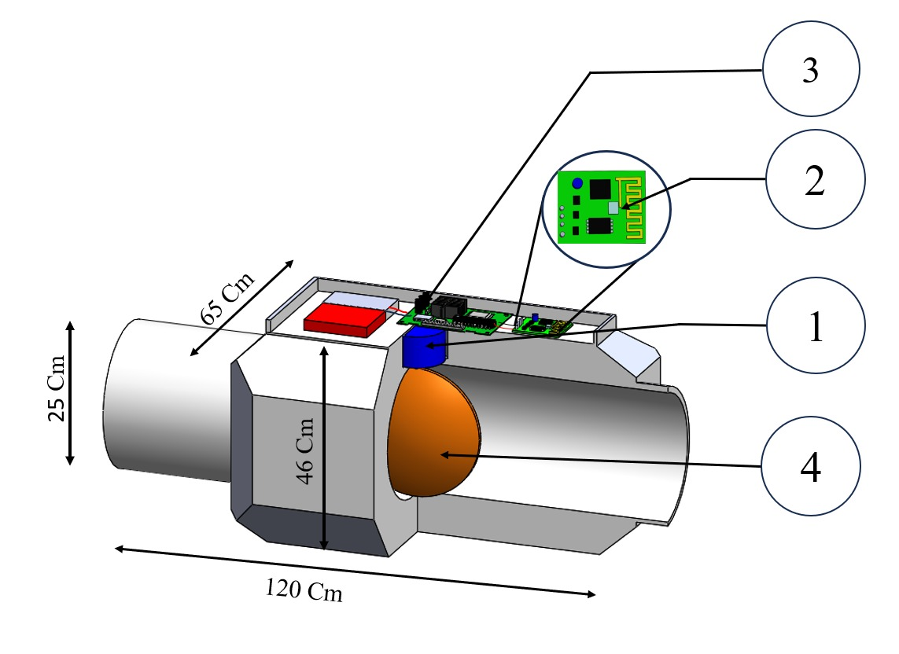
RESULT

Slide 9
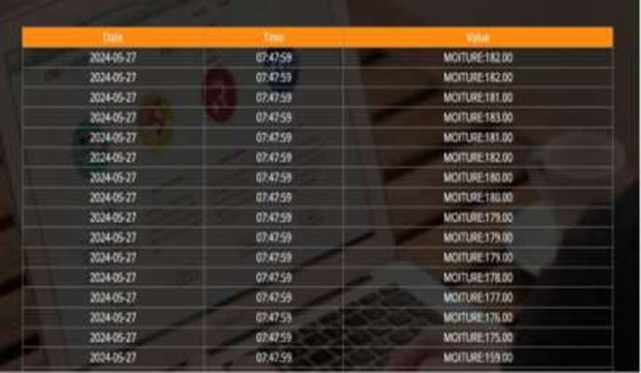


Slide 10
CONCLUSION
The development of a wireless water flow control system tailored for paper and pulp manufacturing presents a crucial opportunity to address existing challenges and enhance operational efficiency in the industry.
By leveraging advanced sensors to monitor pulp and paper density and moisture levels in real-time, the proposed system offers the capability to automatically adjust water flow rates. And it store the history of moisture level.

Slide 11
REFERENCE
https://www.researchgate.net/publication/350771373_Design_and_Development_of_IoT Based Water Flow Monitoring for Pico Hydro Power Plant
https://www.academia.edu/83765873/IV Drip Monitoring and Control
Systemhttps://fluidhandlingpro.com/fluid-process-technology/fluid-flow-control-
measurement/https://www.mdpi.com
https://www.tandfonline.com
https://www.bakerhughes.com/drilling/drilling-fluids/fluids-monitoring-and-reporting- services
https://www.ijert.org/research/smart-water-flow-control-and-monitoring-system- IJERTCONV6IS13071.pdf
https://www.researchgate.net/publication/344408925 Development and Experimental Assessment of a Fluid Flow Motoring System Using Flow Sensor_and_Arduino_I nterface

